Slide 2
Objectives
Understand how and why computers use binary to represent all forms of data
Define the terms bit, nibble, byte, kibibyte, mebibyte, gibibyte, tebibyte, pebibyte and exbibyte
Convert positive denary whole numbers (0-255) into 8-bit binary numbers and vice versa

Slide 3


Starter
What is this symbol?
What numbers is it made from?
How many states does it control?

Slide 4
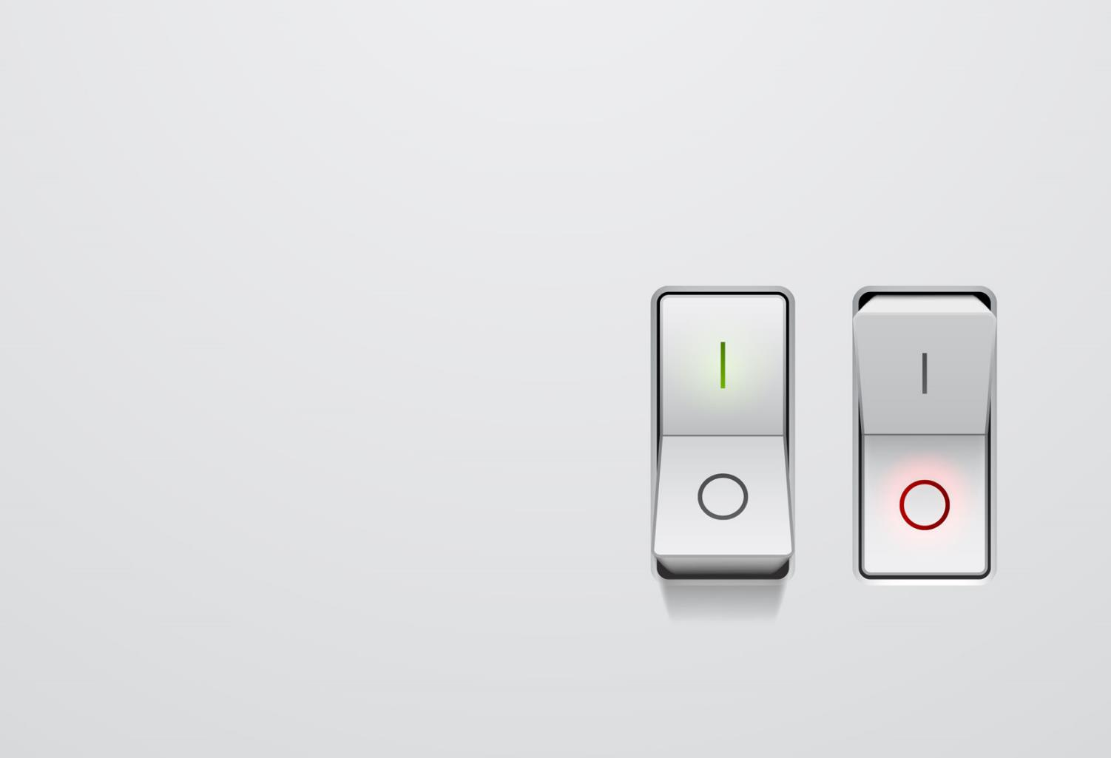
Understanding binary
Computers understand only two states: power on, or power off
This is represented by switches, and computers are essentially calculators made up of billions of switches
Power on = 1
Power off = 0

Slide 5
Binary number system
Computers use a binary number system consisting of only 0s and 1s
Everything that a computer needs to process must be converted into a binary format
This format is used for storing numbers, text, images, sound and program instructions

Slide 6
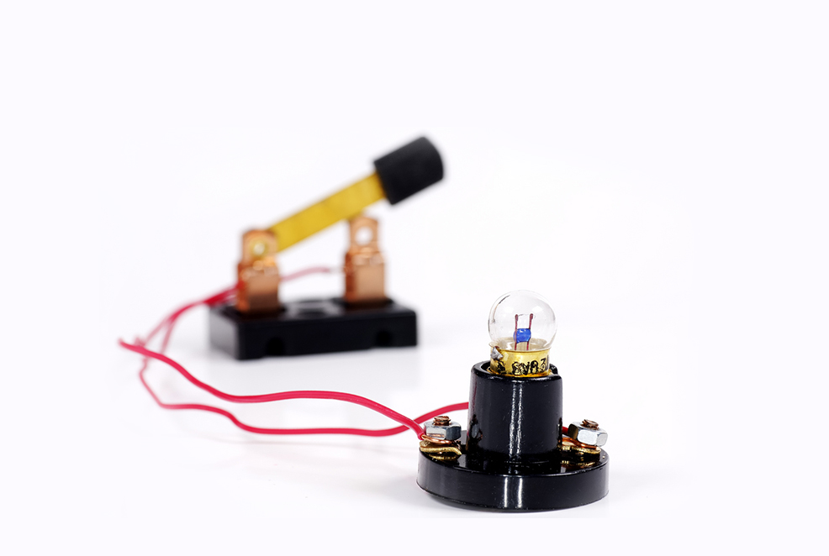
Creating a circuit
Computers comprise billions of switches to turn current on and off

Slide 7
Circuits
Use the keywords below to explain how this electrical circuit works:
+
_
Battery Switch Lamp

Slide 8
Bits and bytes
Many units are used for data storage in computers
1 bit = a single 0 or 1
1 byte = 8 bits = 1 character of text
1 nibble = 4 bits or half a byte
1 KiB (kibibyte) = 1024 bytes
1 MiB (mebibyte) = 1024 KiB
1 GiB (gibibyte) = 1024 MiB
1 TiB (tebibyte) = 1024 GiB
1 PiB (pebibyte) = 1024 TiB
1 EiB (exbibyte) = 1024 PiB
Make a mnemonic for K, M, G, T, P and E

Slide 9
Kibibyte or kilobyte?
1 kilobyte is 1000 bytes
1 kibibyte is 1024 bytes
All other unit prefixes work the same way
1 megabyte is 1000,000 bytes
1 mebibyte is 1,048,576 bytes (1024 x 1024)

Slide 10


Units
One suggestion
Kites – kibi
Make - mebi
Great – gibi
Toy – tebi
Planes – pebi for the
Elderly - exbi

Slide 11
A sense of scale
File | Size
One character of text | 1 byte
A full page of text | 30 KiB
One small digital colour photograph | 3 MiB
Music CD capacity | 650 MiB
DVD capacity | 4.5 GiB
Hard disk capacity | 1 TiB

Slide 12
Binary representation
How many combinations or states can each of the number of switches given produce?
Number of Switches (Bits) | Possible combinations or states
1 | 2
2 | 4
3
4
5
6
7
8

Slide 13
Binary representation
Number of Switches (Bits) | Possible combinations or states
1 | 2
2 | 4
3 | 8
4 | 16
5 | 32
6 | 64
7 | 128
8 | 256

Slide 14
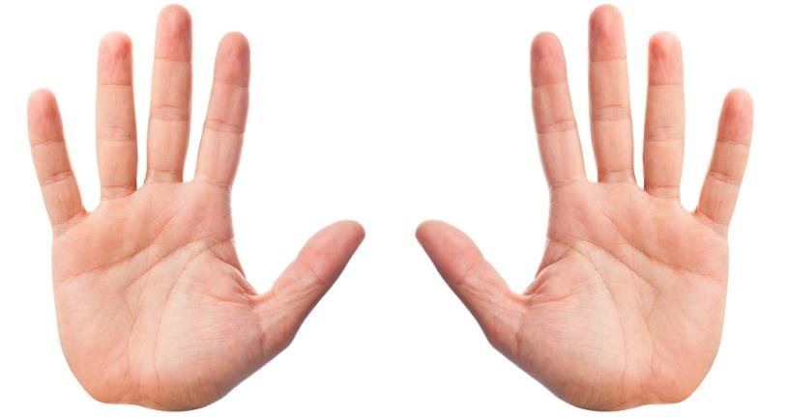
Binary and denary number systems
Denary is a base 10 number system with 10 digits 0-9
Why do we usually use 10 digits?
Binary is a base 2 number system with 2 digits, 0 and 1

Slide 15
Numbers with the denary system
Thousands, Hundreds, Tens and Units
1000 |  | 100 |  | 10 |  | 1
2 |  | 7 |  | 0 |  | 3
2x1000 | + | 7x100 | + | 0x10 | + | 3x1 | = 2703

Slide 16
Binary works in exactly the same way
128 | 64 | 32 | 16 | 8 | 4 | 2 | 1
1 | 0 | 0 | 1 | 0 | 1 | 1 | 0
1x128 | + |  | 1x16 | + | 1x4 + 1x2 |  | = ?

Slide 17
Binary to denary conversion
What is:
128 | 64 | 32 | 16 | 8 | 4 | 2 | 1
0 | 0 | 1 | 1 | 1 | 0 | 0 | 1

Slide 18
Most and least significant bit
The most significant bit (MSB) is the bit with the largest value
This is the bit that is furthest to the left
The least significant bit (LSB) is the bit with the smallest value
This is the bit that is furthest to the right
128 | 64 | 32 | 16 | 8 | 4 | 2 | 1
1 | 0 | 0 | 1 | 1 | 1 | 0 | 1

Slide 19
Representing values
Consider the byte value 0011 1001
This is represented in denary as 57
As an electrical circuit this could be represented as:
0
0
1
1
1
0
0
1

Slide 20
Worksheet 1
Complete Task 1 on Worksheet 1

Slide 21
Denary to binary
How do you convert 28 to binary?
Method
Working right to left, write out the numbers 1, 2, 4, 8 and so on, doubling each time to 128
128, 64 and 32 are all greater than 28, so put a zero for these
Put a 1 in the 16 column, 28 – 16 = 12
Put a 1 in the 8 column, 12 – 8 = 4
Put a 1 in the 4 column, 4 – 4 = 0 so put zero in other columns
128 | 64 | 32 | 16 | 8 | 4 | 2 | 1
0 | 0 | 0 | 1 | 1 | 1 | 0 | 0

Slide 22
Representing large integers
1 byte (8 bits) can represent the numbers between 0 (0000 0000) and 255 (1111 1111)
2⁸ – 1 = 255
What is the largest number that can be held in 16 bits?
What is the largest number that can be held in 32 bits?

Slide 23
Larger numbers
The largest number that can be held with 16 bits is:
2¹⁶ – 1 =
65 536 – 1 =
65 535
(The range of numbers from 0 to 65 535 can be stored in a 16 bit number)
The largest number that can be held with 32 bits is:
2³² – 1 =
4 294 967 296 – 1 =
4 294 967 295

Slide 24
Representing large integers
Computers used to use two bytes to represent an integer
Older versions of Microsoft Excel used to have only 65,536 rows (from 1 to 65,536)
The rows will have been addressed with a two byte integer
Nowadays, they mostly use four bytes
Programmers need to consider the maximum numbers that can be stored by the type of integer they are using

Slide 25
Worksheet 1
Complete Task 2 on Worksheet 1

Slide 26
16-bit conversions
16-bit conversions work in just the same way as 8-bit conversions
The numbers of the columns double for each column to the left:
32768 16384 8192 4096 2048 1024 512 256 128 64 32 16 8 4 2 1
Convert the binary number 1000000000011010 to denary
Convert the denary number 4608 to binary

Slide 27
16-bit conversions
Convert the binary number 1000000000011010 to denary
32768 16384 8192 4096 2048 1024 512 256 128 64 32 16 8 4 2 1 1 0 0 0 0 0 0 0 0 0 0 1 1 0 1 0 = 32768 + 16 + 8 + 2 = 32794
Convert the denary number 4608 to binary
32768 16384 8192 4096 2048 1024 512 256 128 64 32 16 8 4 2 1 0 0 0 1 0 0 0 1 0 0 1 = 0001001000000000
4608 – 4096 = 512
512 – 512 = 0

Slide 28
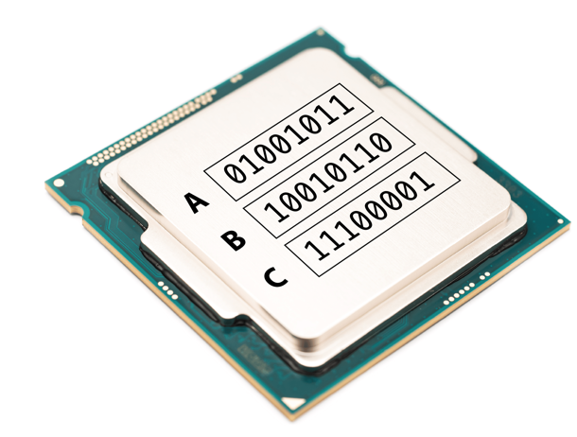
Binary data in computers
Data is processed in computers by the central processing unit (CPU)
CPUs make use of logic gates to process the data
Data is stored in special locations on the CPU known as registers
Look at the values stored in the CPU
What are the values stored in the registers A and B?
What operation (+ or -) was used to reach the answer stored in register C?

Slide 29
Binary data in computers
Register A
This stores 01001011 which is 75 in denary
Register B
This stores 10010110 which is 150 in denary
Register C
This stores 11100001 which is 225 in denary
The CPU has therefore
Processed the calculation: Register C = Register A + Register B

Slide 30
Worksheet 1
Complete Task 3 and Task 4 on Worksheet 1

Slide 31
Plenary
In pairs:
Which numbers are stored in one bit?
How many bits are there in a nibble and a byte?
What are the units after a kibibyte?
What is zero in binary?
What is 255 in binary?
What is 39 in binary?

Slide 32
Plenary
In pairs:
Which numbers are stored in one bit? 0 and 1
How many bits are there in a nibble and a byte? Nibble = 4 bits, byte = 8 bits
What are the units after a kibibyte? mebibyte, gibibyte, tebibyte, pebibyte
What is zero as an 8 bit binary number? 0000 0000
What is 255 in binary? 1111 1111
What is 39 as an 8 bit binary number? 0010 0111

